Slide 1
Bringing Our Community Together Through Gaming!

Slide 2
The B.E.A.S.T. Initiative Table of Contents
Mission and Vision Statements
History Timeline
Programs and Services Offered
STEM/STEAM Focused Programming
Ways to Support
Contact Information

Slide 3
Mission and Vision of The B.E.A.S.T. Initiative
Mission: The BEAST Initiative strives to help youth learn and gain more exposure about the expansive esports and gaming industry; through project-based learning activities, in conjunction with college and career exploration opportunities.
Vision: To be a hub for all things esports and gaming for the youth in our community.

Slide 4
History Timeline
2021: Established partnerships with The Matts Youth Center and Lincoln Charter School.
2021: Established The BEAST Initiative Advisory team (future Board of Directors).
2021: Established Discord Moderator team
2021: Created Youth Leadership Team concept
2022: Established official Youth Leadership Team (6th through 12 graders), which helps expose students to the world of esports and gaming and its college and career opportunities.
December 2018: Hosted 1st Community Game Night for York City
February – July 2019: Hosted various gaming tournaments for youth including Mario Kart, Fortnite, Super Smash Bros. Madden, NBA 2K, and more.
August – November 2019: Setup gaming stations outside for community events including BLIK, Trey & Boo Classic, YMCA Trunk or Treat, Martin Library Cultural Event, Roll R Way Community Day, National Night Out, Rep. Carol Hill Evans Open House.
2020 (The COVID Year): Created our virtual community via Discord. Began to post esports and gaming college and career resources for the youth on Discord.
March - December 2020: Hosted monthly community game night with Call of Duty Mobile, Among Us, Gartic Phone, Minecraft, Fortnite, Kahoot, Apex Legends, etc.
July 2020: Mario Kart tournament at Peoples Bank Stadium in the 1741 Club.

Slide 5
Programs and Services Offered
Youth Leadership Team
Community Outreach through Community Gaming
Educational and Informational Resources for Youth and Parents/Guardians
Tournaments
Community Events

Slide 6
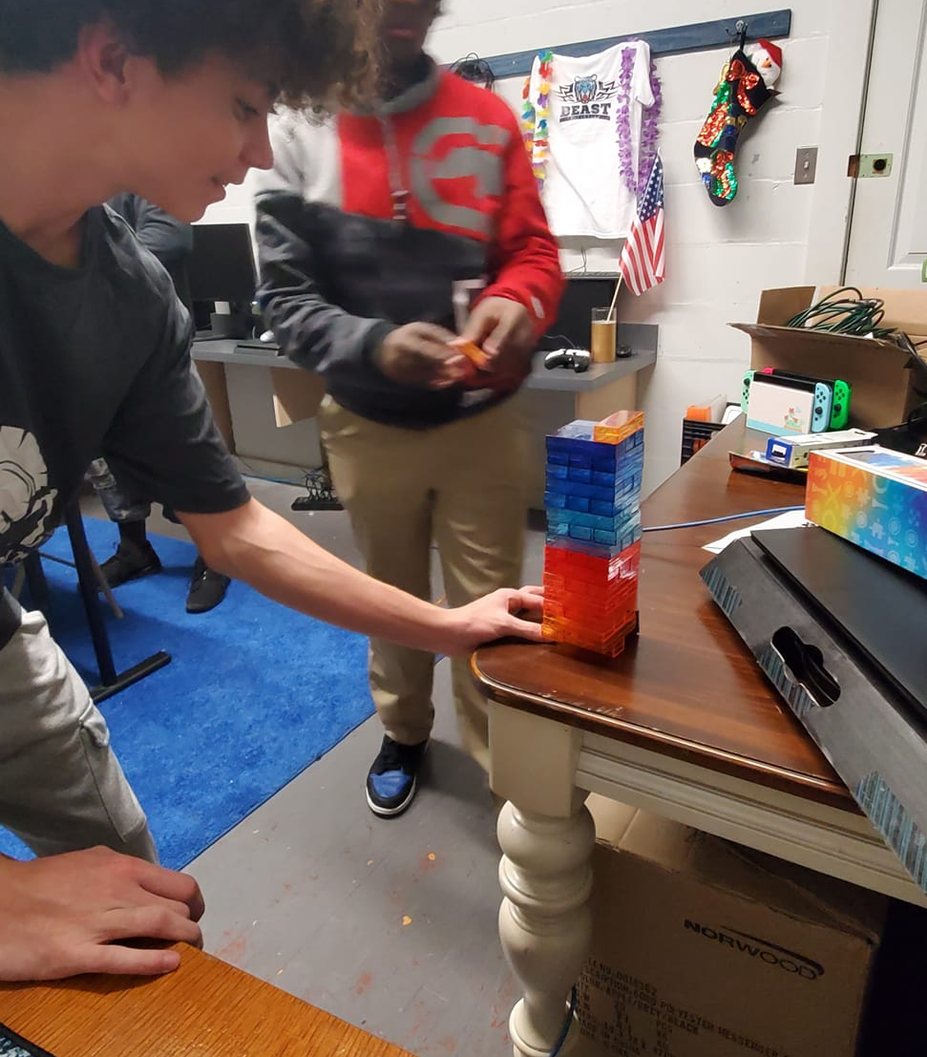
STEM/STEAM Focused Programming
Designing a Community Center of the Future in The Sims 4
Gaming for Good Charity Events

Slide 7
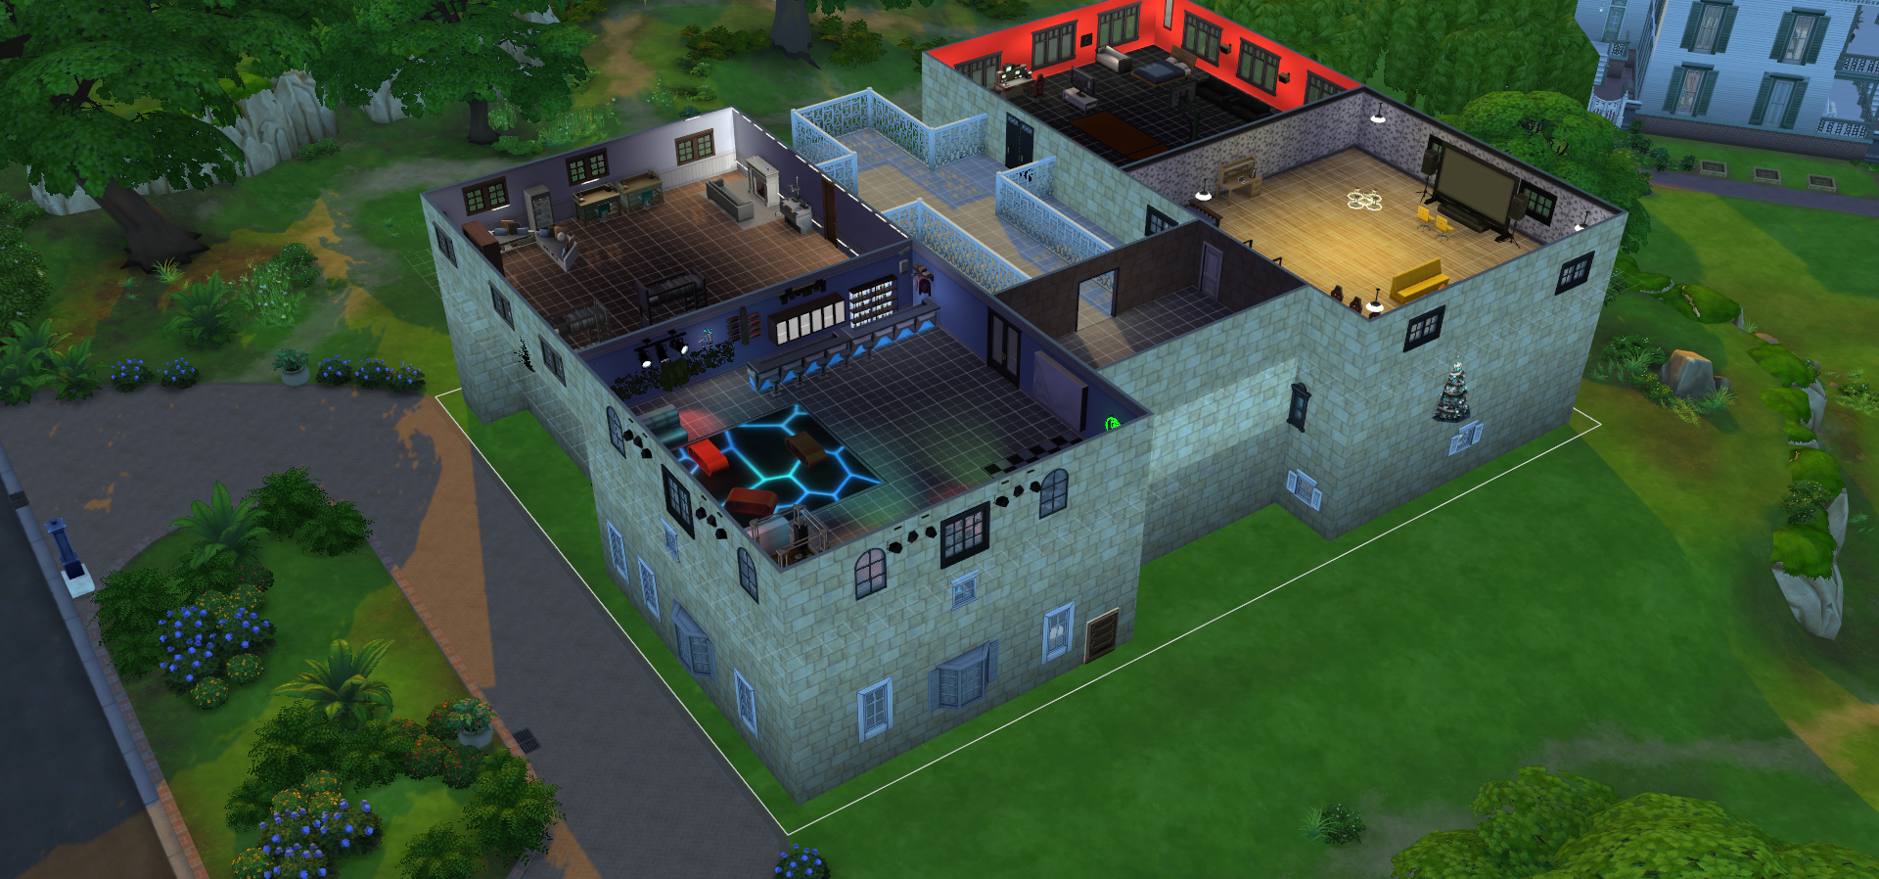
Creating a Community Building in The Sims 4!
Conduct research to determine which services are in your community
Determine which services are missing in your community
Each student will be responsible to work in small groups or individually to create a community space that will help serve their community

Slide 8
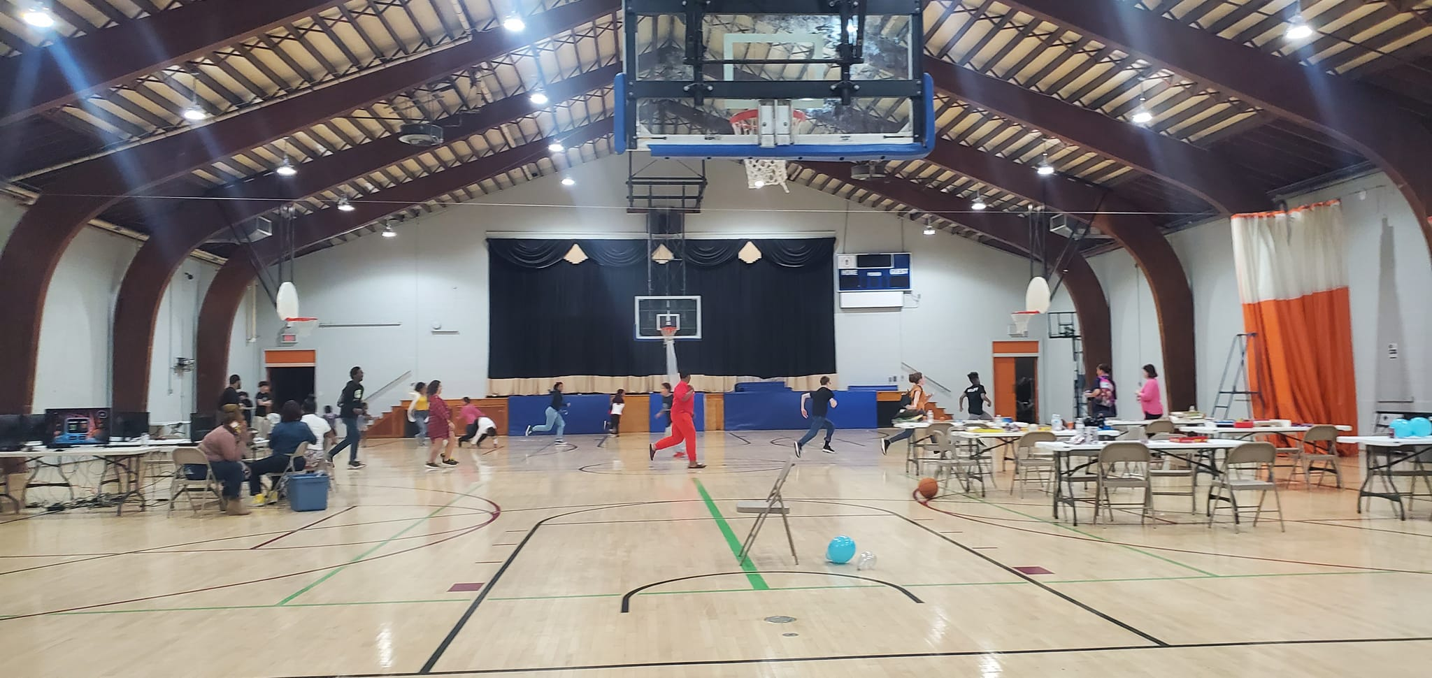
Gaming for Good Charity Events
-Student led, Adult facilitated
-Selection of Charity
-Goal Setting
-Event Planning
-Marketing
-Budget Planning
-Networking

Slide 9
Ways to Support
Become a Mentor/Volunteer with our Youth Leadership Team.
Become a Volunteer for our community events and outreach opportunities.
Donate gaming systems, monitors, controllers, and other gaming related electronics to The BEAST Initiative.
Provide a monetary donation that will help go toward paying for college trips and tours, items we need for community outreach, gift cards for tournaments, etc.
Share our social media and information to your network!

Slide 10
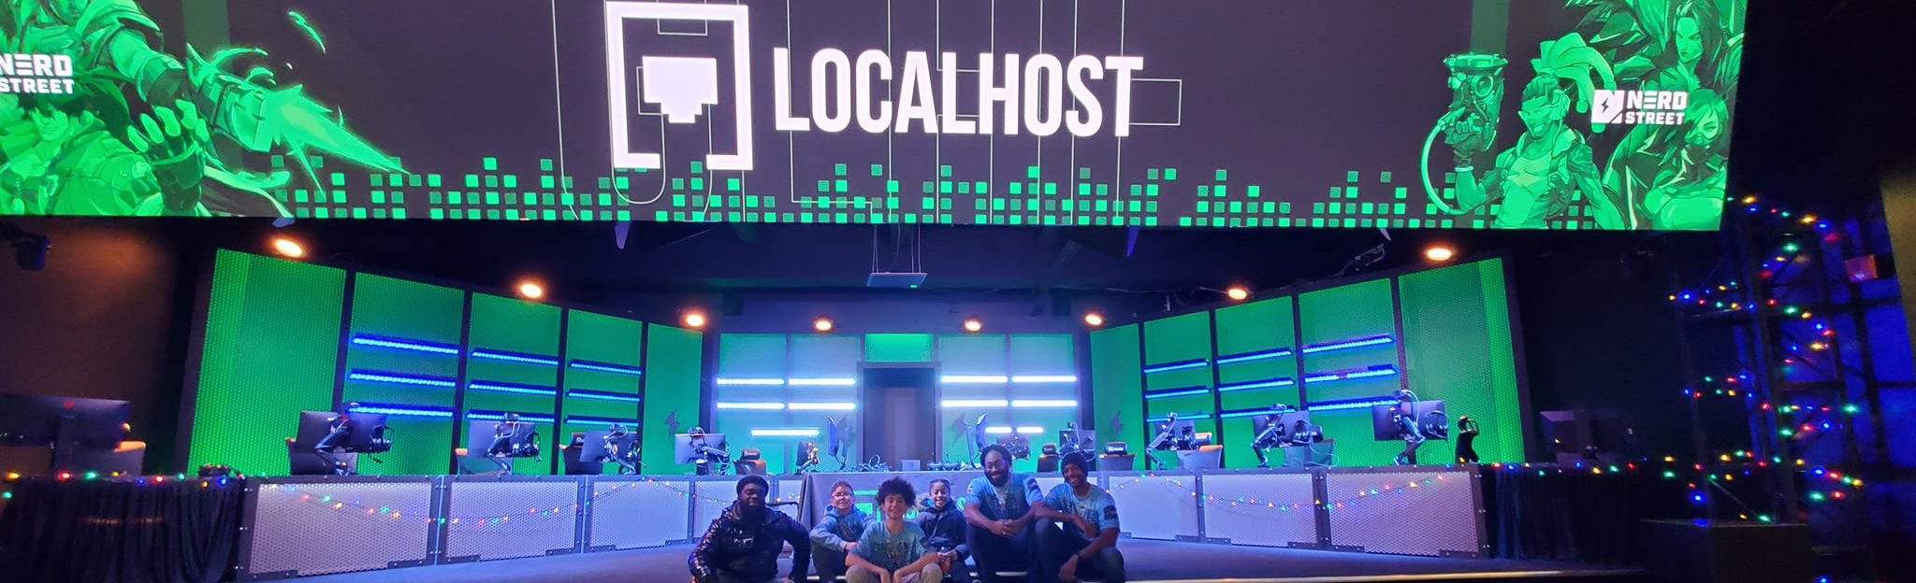
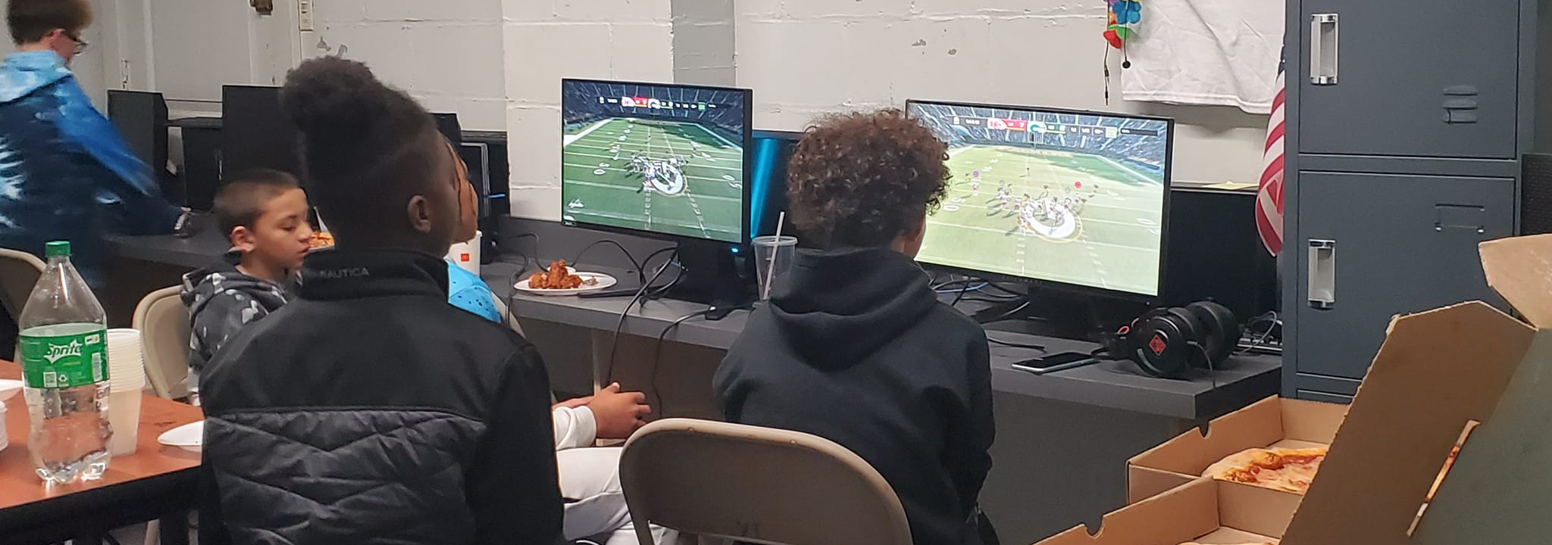
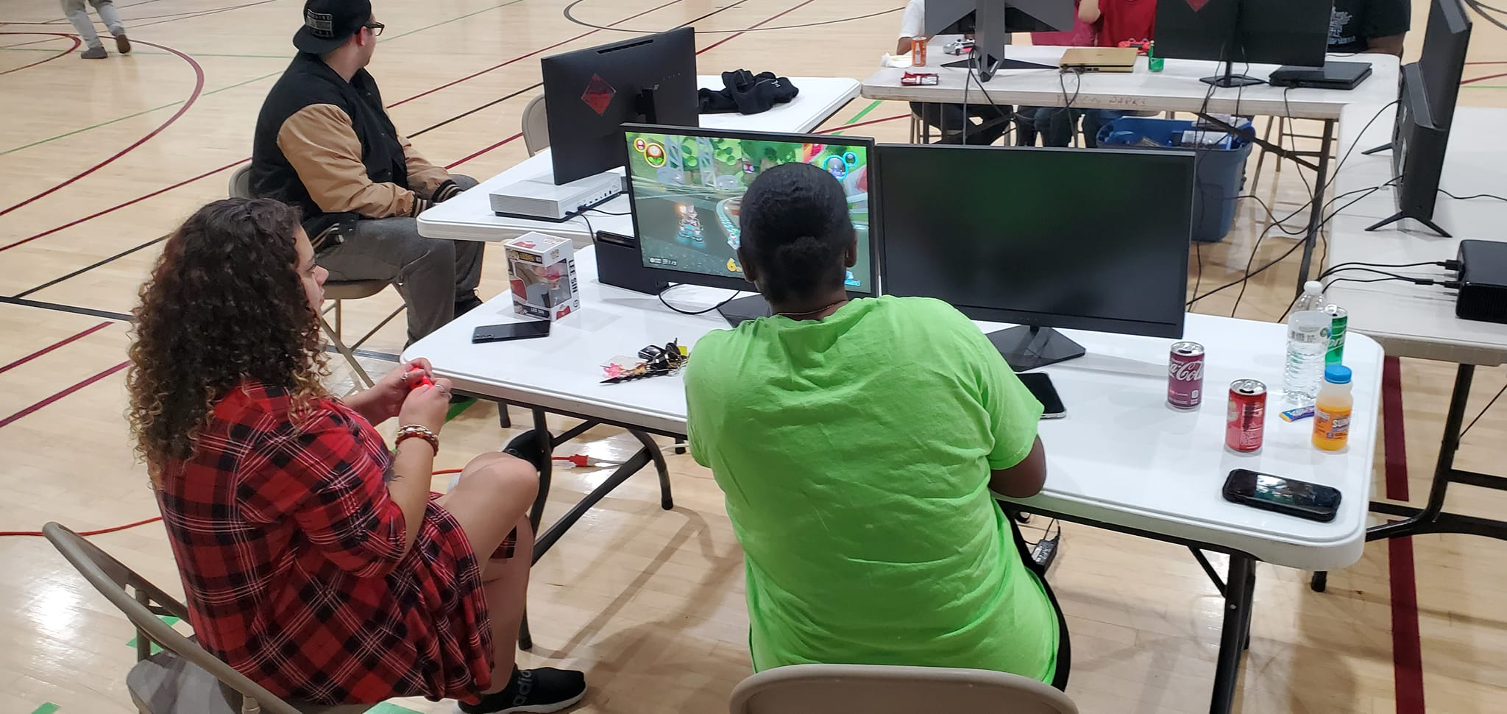
Contact Information
Email: beastinitiativepush@gmail.com
Phone: 717-686-0951
Facebook: https://www.facebook.com/beastinitiative
Twitter: https://twitter.com/beast_push
Instagram: https://www.instagram.com/beast_initiative/
Website: https://beastpush.com

