Slide 1
Youth and Young Adult Program

Slide 2
Who we serve
Youth and Young Adults ages 14-24 who live in the South Central PA region
Meet TANF or WIOA qualifications
TANF - Temporary Assistance for Needy Families
WIOA - Workforce Innovation and Opportunity Act
Justice Involved
Involved in foster care system or have aged out
Inadequate housing
Pregnant or parenting
High school drop-out
Individuals with a documented disability
Low income

Slide 3
Connecting with CareerLink
In-School Youth
Out-of-school youth
Schools
Walk-Ins
PA CareerLink Website
Community Access Points
Referrals to Program Manager
Walk-Ins
PA CareerLink Website
Community Access Points
Referrals to Program Manager

Slide 4
Services provided
Workforce 101
Paid Work Experience
Training
Supportive Services and Incentives
Career Counseling
LinkedIn Learning
Career exposure
Post-Secondary Education exposure
Prologis

Slide 6
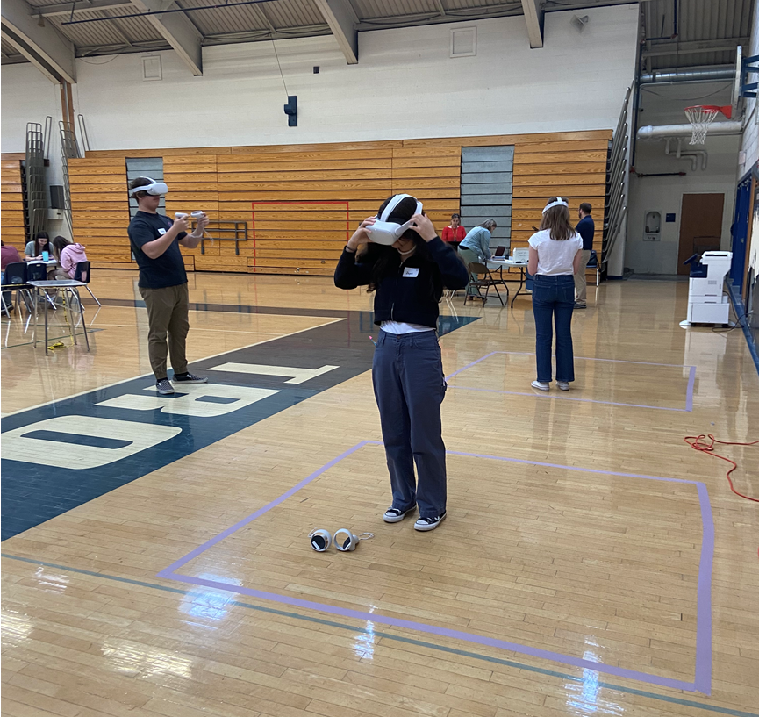
Virtual Reality – Transfer VR

