Slide 2
Postgraduate Survey
Two-Years After Graduation
York Tech Strong. Spartan Proud.

Slide 3
Five-Years After Graduation
York Tech Strong. Spartan Proud.

Slide 4
YCST Big Four Question
Do York Tech students deserve curriculum, instructional delivery, assessment practices, and feedback designed for and relevant to their abilities, interests, and future careers?
York Tech Strong. Spartan Proud.

Slide 5
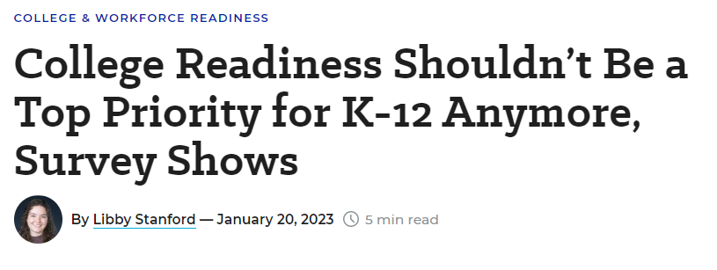
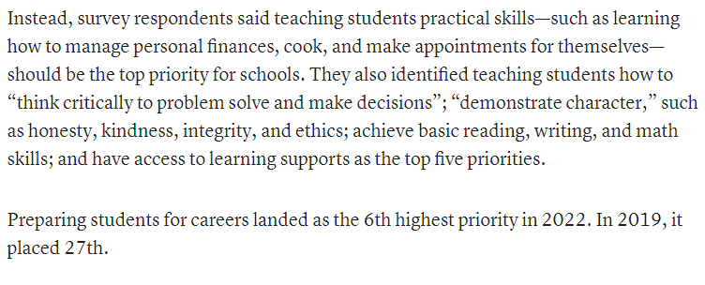
What about non-CTE schools?
York Tech Strong. Spartan Proud.

Slide 6
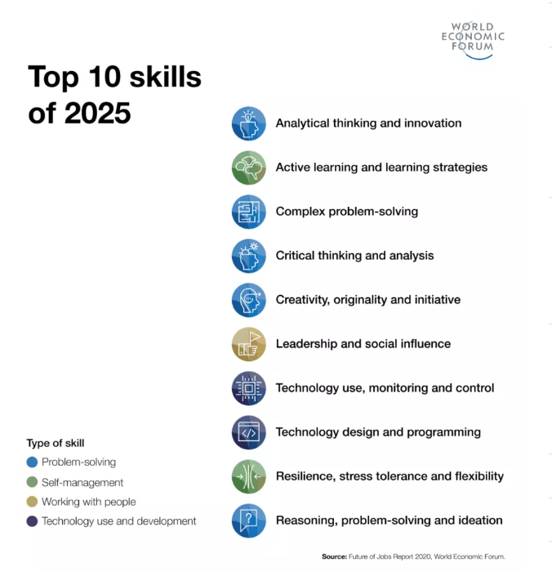
World Economic Forum’s Future of Jobs Report
York Tech Strong. Spartan Proud.

Slide 7
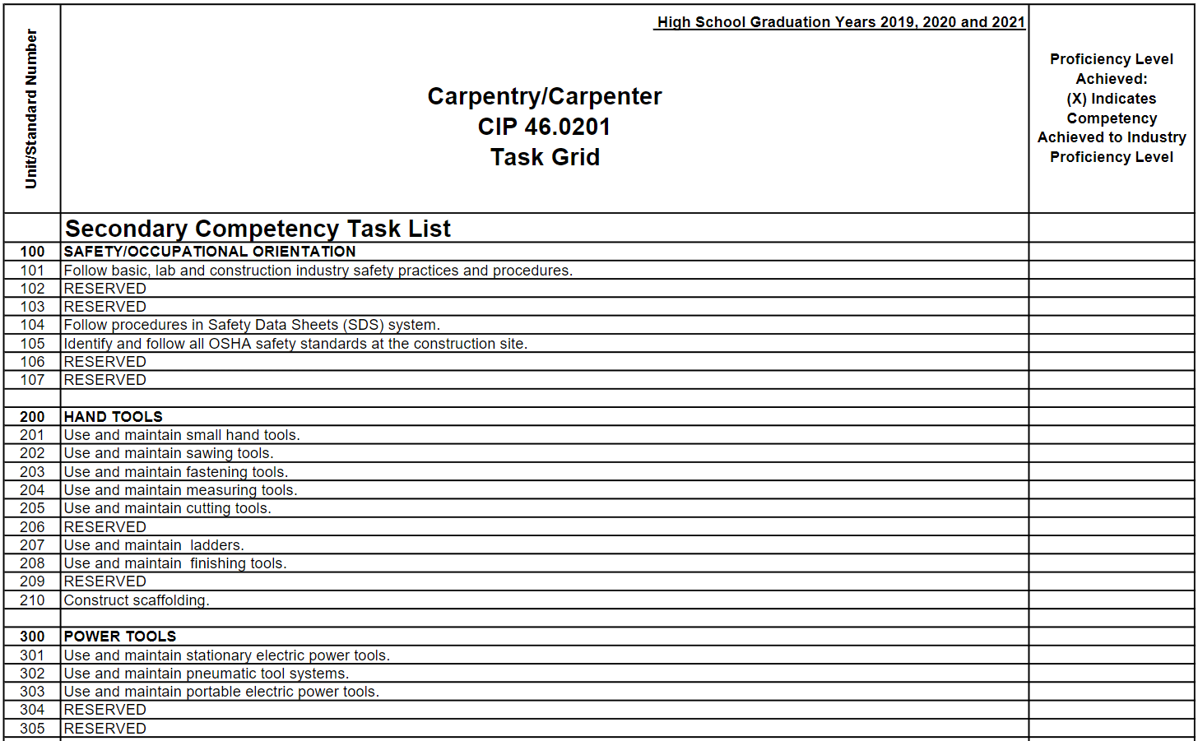
Sample Technical Task List
York Tech Strong. Spartan Proud.

Slide 8
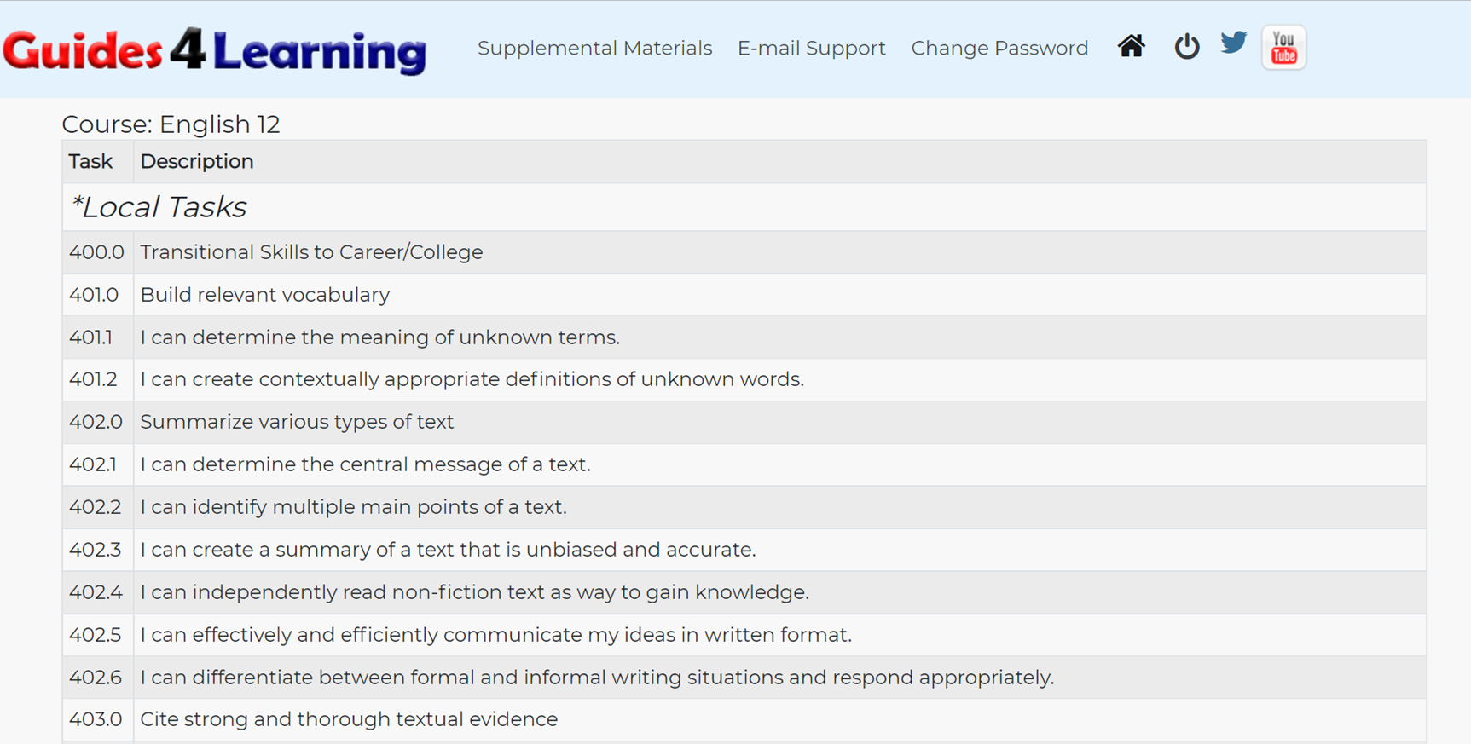
Sample Academic Task List: English
York Tech Strong. Spartan Proud.

Slide 9
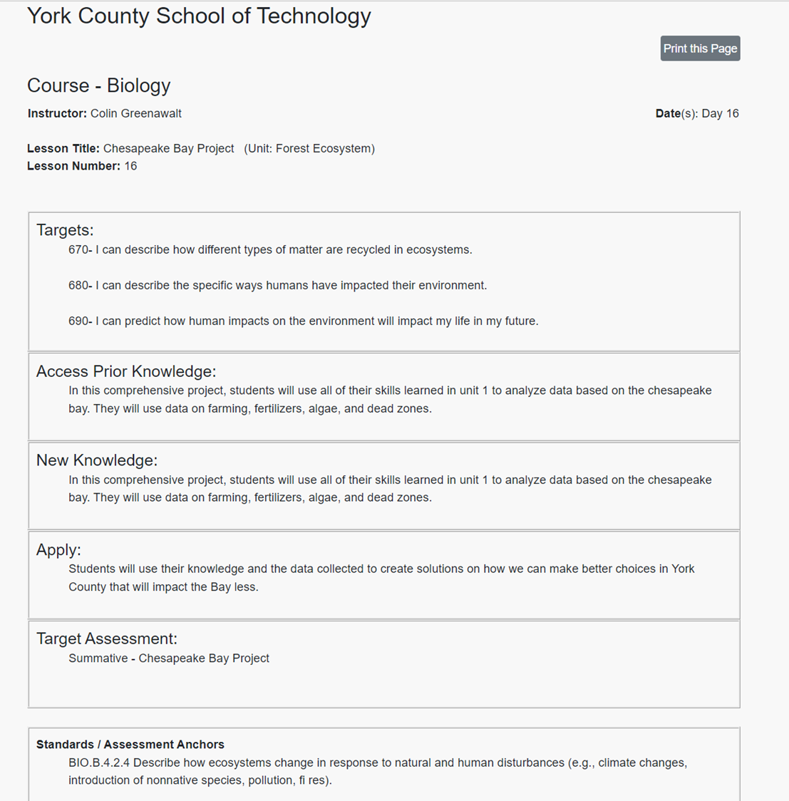
T.A.N.A.T. Lesson Plan
Target
Access Prior Knowledge
New Knowledge
Apply
Target Assessment
York Tech Strong. Spartan Proud.

Slide 10
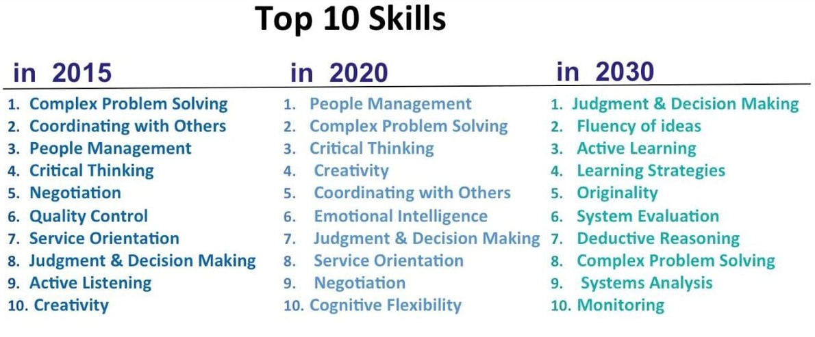
World Economic Forum’s Future of Jobs Report
York Tech Strong. Spartan Proud.

Slide 11
World Economic Forum’s Future of Jobs Report
York Tech Strong. Spartan Proud.

