Slide 1
Pennsylvania Apprenticeship and Training Office (ATO)
Notes:
Thanks so much for joining me this evening! My name is Danielle Demirovic, and I am the pre-apprenticeship manager at the Apprenticeship and Training Office in the PA Department of Labor and Industry. The ATO oversees all policy and program development for the Commonwealth of Pennsylvania related to Registered Apprenticeship and Pre-apprenticeship. We are the main source of technical assistance for registered apprenticeship and pre-apprenticeship for the Commonwealth.
Joe and I help organizations to build apprenticeship and pre-apprenticeship programs, but are also passionate advocates of apprenticeship.

Slide 2
What is Registered Apprenticeship and Pre-Apprenticeship?
Registered Apprenticeship
Registered Pre-Apprenticeship
Paid Job - Apprentices are paid employees who produce high-quality work while they learn skills that enhance their employers' needs
On-the-Job Learning - Hands-on structured training from a mentor at job-site
Classroom Learning - Education in a classroom setting (virtual or in-person) designed to improve job-related skills
Mentorship - Provides apprentices with the support of a skilled worker to assist and enhance critical hands-on learning
Credentials - Offers a portable, nationally-recognized credential to be issued at the completion of the program
Connection to existing apprenticeship programs into which successful pre-apprentices will advance and potentially gain advanced standing
Approved training and curriculum
Hands-on learning with a career focus
Opportunity to earn an industry-recognized credential
Access to support services and career counseling
Notes:
**We won’t talk about the individual elements of each but will instead give brief descriptions.

Slide 3
Benefits of Registered Apprenticeship and Pre-Apprenticeship
Benefits to Apprentices
Paid job from day 1
Clear career pathway with monetary milestones
No student loan debt
Benefits to Parents
No student loan debt
Less uncertainty for child’s future
Benefits to Employers
Higher retention
Customized training to their needs
Benefits to Educational Programming
Act 158
Lower rates of drop-outs
More Options for Students
Boost interest and/or enrollment to existing programs
Program development OR adoption (pre-apprenticeship)
Notes:
**Program development OR adoption is the segue into the following slide, which highlights the pre-apprenticeship to apprenticeship ecosystems that are available in their area.

Slide 4
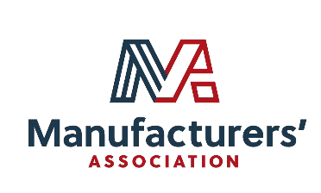
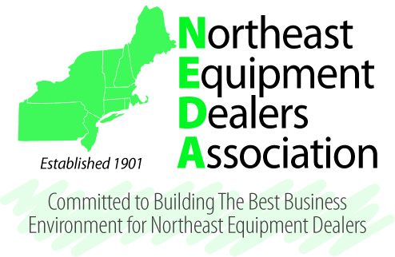
Programs in Your Area
Notes:
As a school, if you are unable to create your own pre-apprenticeship to apprenticeship ecosystem, there are plenty of existing options for your students in this area.
YEI have accepted 18 pre-apprentices into our apprenticeship program. They had a student that was able to skip the entire first year of apprenticeship because he was successful in the pre-apprenticeship.
IEC’s success story was about a pre-apprentice that completed his pre-apprenticeship, was accepted into a registered apprenticeship, and closed on a house the day after he graduated high school

Slide 5
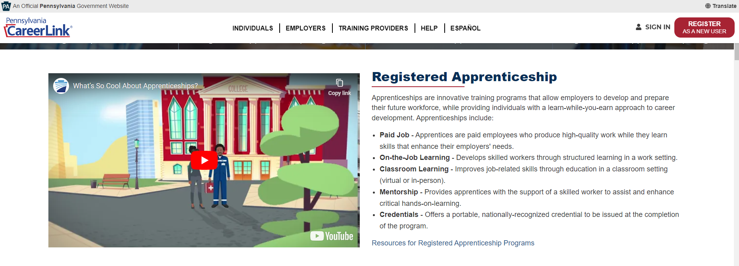
CareerLink Apprenticeship Website
https://www.pacareerlink.pa.gov/jponline/Common/Apprenticeships
What’s So Cool About Apprenticeship? Video

Slide 6
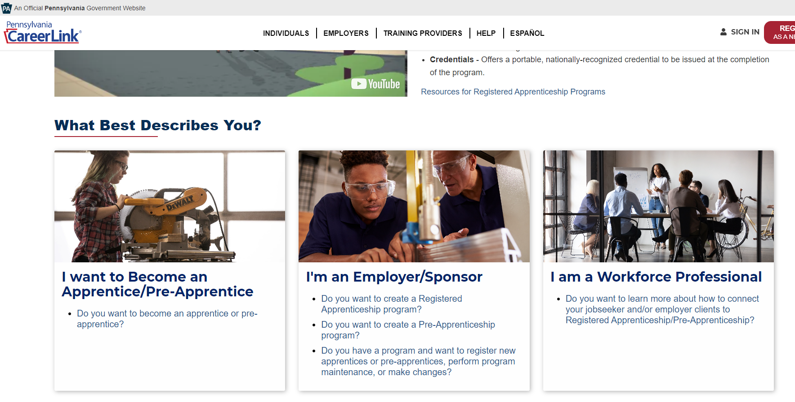
CareerLink Apprenticeship Website
https://www.pacareerlink.pa.gov/jponline/Common/Apprenticeships
Resources for Job Seekers and Employers

Slide 7
Start your Journey Here!
PA CareerLink, Apprenticeship Webpage: https://www.pacareerlink.pa.gov/jponline/Common/Apprenticeships
Joseph E. Bass III
Apprenticeship & Training Representative
Apprenticeship & Training Office
Department of Labor & Industry
jobass@pa.gov
Danielle Demirovic
Pre-Apprenticeship Manager
Apprenticeship & Training Office
Department of Labor & Industry
ddemirovic@pa.gov

