Slide 1
ACT 158 and PDE Updates YCAL – 2/03/2023 Laura Fridirici, Career Readiness Advisor

Slide 2
Background (Pa. Act 158 of 2018)
Expands the options for students to demonstrate readiness for postsecondary success beyond solely proficiency on all 3 Keystone Exams.
Statewide graduation requirement outlined in Act 6 takes effect for the graduating class of 2023.

Slide 3
Background (Pa. Act 136 of 2020)
Extends the timeline for implementation of new statewide graduation pathways enacted by Act 158 by one year to 2022-2023.
Students who take a Keystone-related course during a year when annual state testing requirements are waived are deemed proficient, provided they meet locally established grade-based requirements for the academic content associated with the exam.
Provides the Secretary of Education with authority to waive the NOCTI/NIMS assessments, if appropriate, on a schoolwide basis or for a specific career and technical education program provided by a school entity for the 2020-2021 school year.

Slide 4
Proficiency vs. Composite vs. Additional Pathways
Keystone Composite Score is ≥4452
(w/at least one score Proficient or Advanced and no score Below Basic)
Proficiency on local grade-based requirements PLUS CTE, Alternative Assessment, Evidence-based
Proficient or Advanced in all Keystone Exams

Slide 5
Keystone Proficiency Pathway
Scoring proficient or advanced on each Keystone Exam:
Algebra I
Literature
Biology
Minimum scaled score per assessment = 1500

Slide 6
Keystone Composite Pathway
Earning a satisfactory composite score on the Algebra I, Literature, and Biology Keystone Exams
Achieving at least a proficient score on at least one of the three exams and no less than a basic score on the remaining two exams
Composite score = 4452

Slide 7
Career and Technical Education Pathway
Successful completion of locally established grade-based requirements for each Keystone Exam content area in which the student was less than proficient and one of the following:
Attainment of an industry-based competency certification related to the CTE Concentrator’s program of study
Demonstration of a high likelihood of success on an approved industry-based competency assessment
Readiness for continued meaningful engagement in the CTE Concentrator’s program of study

Slide 8
Alternate Assessment Pathway
Successful completion of locally established grade-based requirements for each Keystone Exam content area in which the student was less than proficient and one of the following:
Attainment of an established score on an approved alternative assessment:
Scholastic Aptitude Test (SAT/PSAT) and American College Testing (ACT) exam
ACT WorkKeys (National Career Readiness Certificate)
Advanced Placement and International Baccalaureate tests and coursework
Armed Services Vocational Aptitude Battery exam
Successful completion of a concurrent enrollment course in an academic content area associated with each Keystone Exam in which the student did not achieve at least a proficient score
Successful completion of a pre-apprenticeship program
Acceptance in an accredited 4-year nonprofit institution of higher education and evidence of the ability to enroll in college-level coursework

Slide 9
Alternate Assessment Pathway (cont.)
SAT: 1010
PSAT: 970
ACT: 21
ASVAB: 31 (minimum to qualify for placement into one of the branches of the US military)
ACT WorkKeys: Gold Level (Per Act 158)
AP: An established score of 3 or higher on an approved AP course in an academic content area associated with each Keystone Exam on which the student did not achieve at least a proficient score
IB: An established grade of 4 or higher on an approved IB course in an academic content area associated with each Keystone Exam on which the student did not achieve at least a proficient score

Slide 10
Evidence Based Pathway
Successful completion of locally established grade-based requirements for academic content areas associated with each Keystone Exam on which the student did not achieve proficiency
AND THREE PIECES OF EVIDENCE:

Slide 11
Evidence Based Pathway (cont.)
Minimally one of the following (two or all three permissible):
Attainment of an established score on an alternate assessment
Acceptance to an other than 4-year accredited nonprofit institution of higher education
Attainment of an industry recognized credential
Successful completion of a concurrent enrollment or postsecondary course
AND/OR

Slide 12
Optional Supplemental Evidence
Up to two of the following:
Service Learning Project completion
Proficient or Advanced on a Keystone Exam
Letter guaranteeing full-time employment
Internship or Cooperative Education Program
Compliance with NCAA’s core courses for college-bound student athletes

Slide 13
Approved Assessment Scores
ACT WorkKeys: Silver Level or higher
SAT Subject Test: 630
Advanced Placement: 3 or higher
International Baccalaureate: 3 or higher

Slide 14
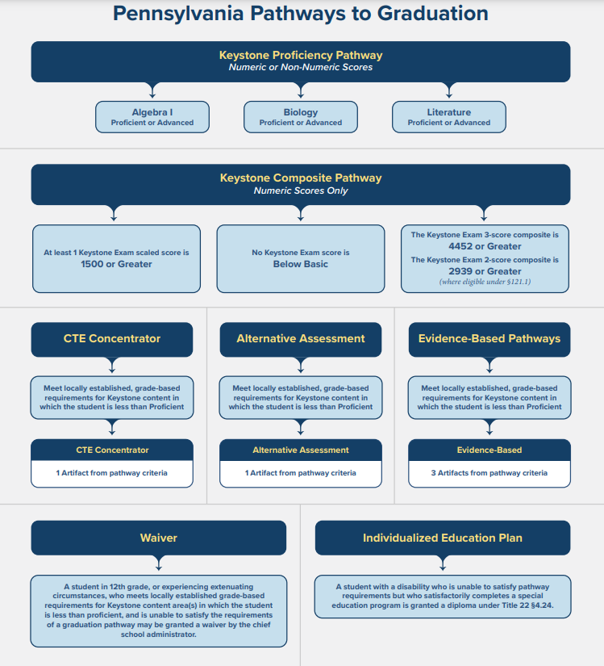

Slide 15
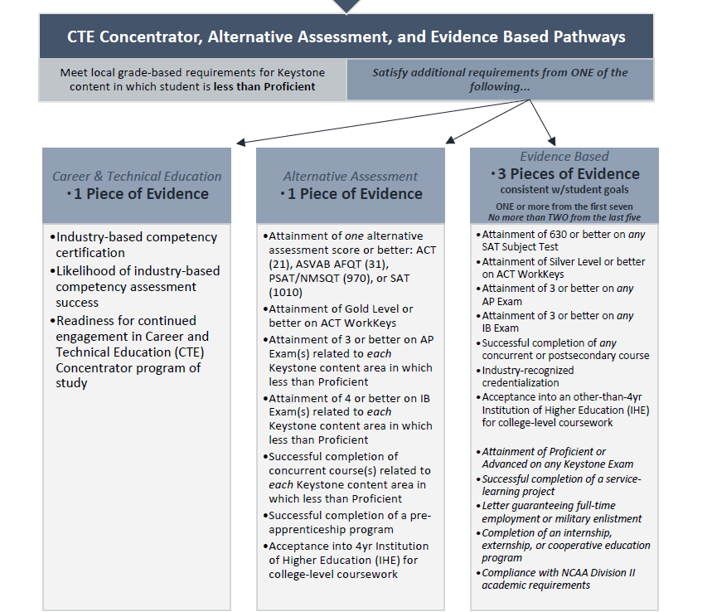
CTE Concentrator, Alternative Assessment, and Evidence Based Pathways Graphic

Slide 16
Industry Based Learning – Industry Credentials
Industry-Recognized Credentials For Career And Technical Education Programs Resource Guide provides an annual listing of credentials. To identify and report industry credentials for non-CTE students, use the guidance on the Career Ready PA webpage.

Slide 17
Industry Credentials - Reporting
For CTE students, reporting requirements have not changed.
For non-CTE students, the industry credential should:
Align to student’s career plan or interest and/or academic program of studies
Align to one of the 16 Career Cluster Codes
Align to Workforce Demand

Slide 18
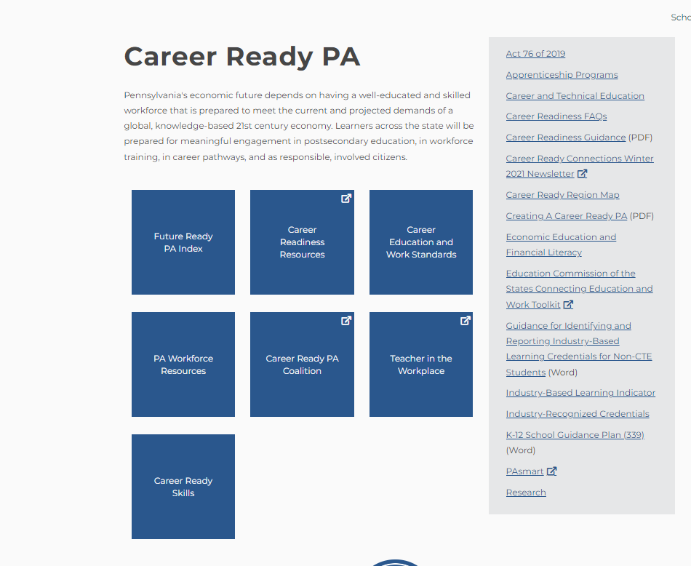
Career Ready PA Landing Page - PDE

Slide 19
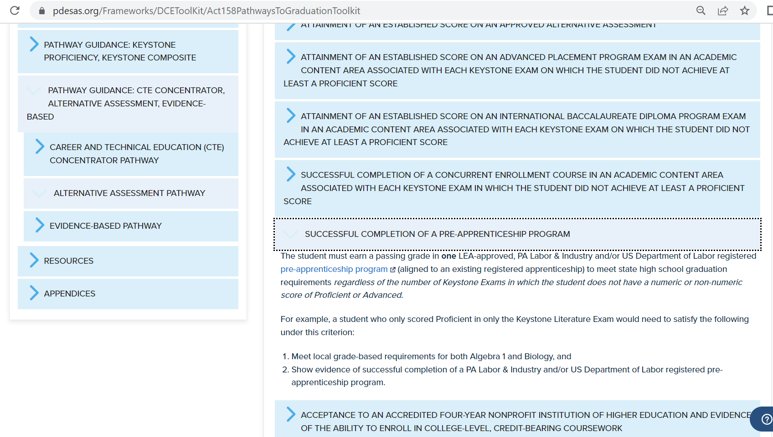
Act 158 Pathways Toolkit (SAS)

Slide 20
Act 158 Toolkit Resources
PDE SAS Act 158 Pathways to GraduationToolkit
Pennsylvania Pathways to Graduation Graphic
Comparison of Student Evidence Guide
RA Account:
RA-EDGRADREQUIREMENT@pa.gov
Notes:
4. Assign the content areas so that there is at least one person/group assigned to every subject level. Have the participants write down their ideas. They do not need to get into specific objectives, just an overview of an idea that a teacher could build upon. After a sufficient amount of time, let them share the ideas for content-area lessons.

Slide 21
Web Resources
Career Ready PA PDE website:
https://www.education.pa.gov/K-12/CareerReadyPA/Pages/default.aspx (link to Word document for Guidance for Reporting and Identifying Industry-Based Learning Credentials for Non-CTE Students)
Industry-Based Learning Indicator Guidance
https://www.education.pa.gov/K-12/ESSA/FutureReady/Pages/FRIndustryGuidelines.aspx
Industry Recognized Credentials for Career and Technical Education Programs
https://www.education.pa.gov/K-12/Career%20and%20Technical%20Education/Resources/Teacher%20Resources/IndustryRecognized/Pages/default.aspx
Work-Based Learning Toolkit (SAS website)
https://www.pdesas.org/Frameworks/DCEToolKit

Slide 22
Resources
RA Account
RA-EDGRADREQUIREMENT@pa.gov
FAQs
Act 158: Pathways to Graduation Toolkit - SAS (pdesas.org)

Slide 23
Contact/Mission
For more information on the Act 158, please visit PDE’s website.
The mission of the Department of Education is to ensure that every learner has access to a world-class education system that academically prepares children and adults to succeed as productive citizens. Further, the Department seeks to establish a culture that is committed to improving opportunities throughout the commonwealth by ensuring that technical support, resources, and optimal learning environments are available for all students, whether children or adults.

